Slide 1
Orama X – Exoplanet Detector
AI-powered identification of exoplanets using open NASA datasets
Team Members:
Theodoros Silvestros,
Andriani Christoforou,
Nikolaos Silvestros
Event: NASA International Space Apps Challenge 2025

Slide 2

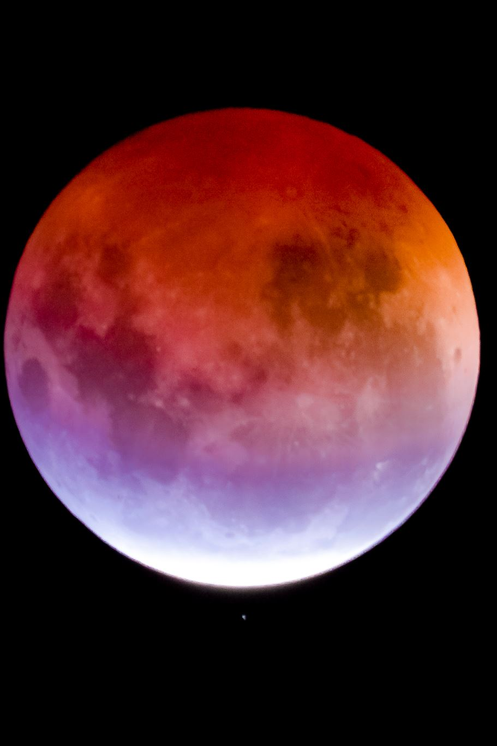
Problem & Impact
Thousands of exoplanets have been found, but many are still detected manually.
Manual detection is slow and can miss smaller or dimmer planets.
Our impact:
- Automates planet detection using NASA’s open data Kepler, K2, TESS.
- Speeds up discovery and helps scientists focus on analysis instead of manual work.
- Inspires collaboration between astronomy and AI research.

Slide 3
Creativity & Innovation
Our innovation:
- Combines classical algorithms (BLS method) with modern AI (CNN model).
- Uses light curve and phase-folded data to confirm potential planets.
- Integrates automatic filtering, model fitting, and visual analysis.
Why it’s new:
- Merges astrophysics and machine learning into an easy-to-use web tool.
- Provides automatic “planet or not” classification — something usually done by experts.

Slide 4
Scientific Validity
Grounded in science:
- Based on the transit method — detecting light dips as a planet crosses in front of its star.
- Uses phase-folding to align all transits into one cycle for clearer visibility.
- Incorporates NASA’s calibrated photometric data from the MAST archive.
AI system:
- Still under development, trained on labeled datasets (planet vs non-planet).
- Can upload new data, explain predictions, and retrain the model for better accuracy.

Slide 5

Relevance & Integration
Relevance to NASA’s mission:
- Uses real NASA data to explore planets beyond our solar system.
- Supports the broader goal of identifying habitable worlds.
- Can easily integrate with other NASA tools and research pipelines.
How it helps science:
- Acts as a filtering assistant for astronomers.
- Reduces false positives and highlights strong planet candidates.

Slide 6
Presentation & Communication
How we communicate our project:
- Clear visuals (light curves, phase-folded plots, Gaia validation).
- Simple explanations for complex processes (AI + astronomy).
- Transparent workflow showing how data becomes detection.
Key message:
“We make exoplanet discovery faster, smarter, and open for everyone.”

Slide 7
Results, Next Steps & Vision
Current model can detect possible exoplanets from light curve data.
Ongoing improvements to AI (CNN) to increase accuracy.
Plan to include automatic validation with Gaia data and public dataset updates.
Our vision:
To make exoplanet detection fully automated, accessible, and scalable — helping NASA and the scientific community find new worlds faster.

